Slide 1
Title IX Advisor Training
Cheryl Schuetze
Senior Counsel
Office of the General Counsel
September 17, 2025

Slide 2

Title IX
"No person in the United States shall, on the basis of sex, be excluded from participation in, be denied the benefits of, or be subjected to discrimination under any educational program or activity receiving Federal financial assistance."
Title IX of the Education Amendments of 1972

Slide 3
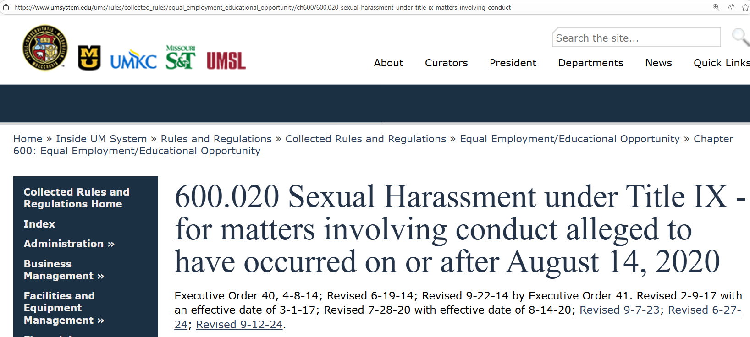
Title IX at University of Missouri
Notes:
Go to the CRRs
600.020 – what is prohibited
600.030 – process
Highlight, note, keep with you (see my binder?)

Slide 4

Prohibited Conduct
University policy “prohibits all students, employees, volunteers and visitors at the University from engaging in sexual harassment in a University education program or activity against a person in the United States.”
CRR 600.020.A

Slide 5
Sexual Harassment: Conduct on the basis of sex that satisfies one or more of the following:
Hostile Environment
Severe
Pervasive
Objectionably offensive
Denies equal access
Quid Pro Quo
Dating Violence
Domestic Violence
Sexual Assault
Rape
Sodomy
Sexual Assault with an Object
Fondling
Incest
Statutory Rape
Stalking
CRR 600.020.B.1

Slide 6
Advisors
Advisors. The individuals selected by the Complainant and the Respondent, or if a Party does not have their own Advisor, selected by the University, to conduct all cross-examination and other questioning on behalf of a Party at a hearing; an Advisor may, but is not required to, be an attorney.
CRR 600.030.C.4
Notes:
NOT GIVING LEGAL ADVICE

Slide 7
Role of Advisors
Conduct cross-examination and other questioning for that Party. A Party may not directly question any other Party or any witness; all cross-examination and other questioning on behalf of a Party must be conducted by their Advisor.
Ask the other Party and any witnesses all relevant questions and follow-up questions, including those challenging credibility. An Advisor may conduct cross-examination and other questioning for a Party, and object to questions on limited grounds as specified in the Rules of Decorum.
The Advisor may not make a presentation or otherwise represent the Complainant or the Respondent during the hearing.
The Advisor may consult with the Party quietly or in writing, or outside the hearing during breaks, but may not speak on behalf of the Party, other than to conduct cross-examination or other questioning for the Party.
CRR 600.030.K.2
Notes:
Limited role. You are NOT their attorney. But they’ll treat you that way.

Slide 8
Title IX Flow
Complaint
Notice of Allegations
Investigation
Resolution
Informal
Administrative
Hearing Panel
Or maybe here
Here’s where you come in
CRR 600.030
Notes:
Definitely before the hearing
Sometimes when the investigative report is being finalized, if it is clear there will be a hearing resolution rather than one of the others.
600.030.L says the parties will get access to the investigative report and evidence 10 business days before it is completed to give a written response.
Parties have to tell the TIX Coordination at least 10 business days prior to the hearing whether they intend to bring an advisor of their choice or want the University to provide one. That may only give you 2 weeks to prepare.

Slide 9
Title IX Pre-Hearing Process
Notice of Hearing
20 business days before hearing
Description of alleged violation
Copy of final investigative report and evidence
Notice of how to request evidence not in the report
Panel members
CRR 600.030.Q.3
Notes:
Charging document
Review panel members with CP to see if there is a conflict

Slide 10
Title IX Pre-Hearing Process
At least 15 business days before hearing provide investigator:
Witness List & Documentary Evidence
list of all names of proposed witnesses intends to call at the hearing
Copies of all exhibits intends to use at the hearing
Objection to Panel Members
CRR 600.030.Q.4-5

Slide 11
The Hearing
CP may give a statement
Panel asks questions
Cross Exam by RP’s advisor
CP calls witnesses
Panel asks questions
Cross Exam by RP’s advisor
RP may give a statement
Panel asks questions
Cross Exam by CP’s advisor
RP calls witnesses
Panel asks questions
Cross Exam by CP’s advisor
Investigator answers questions
Panel asks questions
Cross Exam by CP’s advisor
Cross Exam by RP’s advisor
Investigator calls witnesses
Panel asks questions
Cross Exam by CP’s advisor
Cross Exam by RP’s advisor
All parties can submit documentary evidence
CRR 600.030.Q.10.a
Notes:
The Hearing Panel may ask questions of the Parties or any witnesses including the Investigator at any time during the hearing.

Slide 12
Hearing Process Rules
The formal rules of evidence shall not apply
Relevancy and admissibility of any evidence shall be determined by the Hearing Officer, whose ruling shall be final
Advisors may object to questions on limited grounds as specified in the Rules of Decorum
Procedural questions not covered by CRR will be decided by the Hearing Officer
CRR 600.030.Q.11

Slide 13

Title IX No-Nos
Not Subject to Cross = No Reliance
“If a Party or witness does not submit to cross-examination at a hearing, the Hearing Panel must not rely on any statement of that Party or witness in reaching a determination regarding responsibility, but no inference can be drawn from the fact that a Party or witness failed to submit to cross-examination.”
CRR 600.030.Q.11.1

Slide 14
Title IX No-Nos
Not Subject to Cross = No Reliance
No Character Evidence
No Other Bad Acts (unless shows pattern
No Dr/Patient Records
No Privileged Records
No Violation of Rules of Decorum
CRR 600.030.Q.11.1

Slide 15

Burden of Proof
The standard of proof will be “preponderance of the evidence,” defined as determining whether the evidence shows it is more likely than not that a policy violation occurred.
Presumed Not Responsible
Notes:
51%
True for each fact
True for overall responsibility
Presumed Not Responsible

Slide 16
I Consent

Slide 17

Scenario
CP is a 19-year-old Freshman sorority member
RP is a 19-year-old Freshman fraternity member
CP and RP meet at a party at his fraternity
Both consume 4-5 cups of the “social drink”
CP & RP go to RP’s room and have sex
CP files a Title IX complaint, claiming she was too intoxicated to consent

Slide 18
Consent
Consent to sexual activity is knowing and voluntary.
No consent if:
Younger than legal age (17 years-old)
Incapacitated
Coercion, force, or threat of either
“It is the responsibility of each person to ensure they have the consent of all others engaged in the sexual activity.”
CRR 600.020.B.2-3

Slide 19
Consent
Consent, lack of consent, or withdrawal of consent:
Words
Non-Verbal Acts
Silence or absence of resistance does not establish consent.
Current or former relationship or activities does not alone indicate consent
Consent to one activity does not imply consent to other activities
CRR 600.020.B.2

Slide 20
Consent - Incapacitation
Incapacitation: rational decision-making is rendered impossible
Drugs
Alcohol
Disability
Sleep
Unconsciousness
Illness
Respondent knew or should have known
CRR 600.020.B.3

Slide 21
Consent - Incapacitation
Indicators of incapacity
Lack of awareness of circumstances or surroundings (e.g., an inability to understand, either temporarily or permanently, the who, what, where, how and/or why of the circumstances; blackout state)
Inability to physically or verbally communicate coherently, particularly with regard to consent (e.g., slurred or incoherent speech)
Lack of full control over physical movements (e.g., difficulty walking or standing without stumbling or assistance)
Physical symptoms (e.g., vomiting or incontinence).
CRR 600.020.B.3

Slide 22
Consider the Evidence - Object?
CP flirted with multiple men at the party
Someone took pictures of CP making out with RP at the party and sent them to her boyfriend
CP goes to parties every weekend and consistently drinks multiple drinks
CP went to the hospital the next day to get a tox screen and a rape kit completed
Witness who took the pictures does not attend the hearing
RP invokes the 5th amendment – appears but does not answer questions
RP answers questions, but states he was too drunk to remember anything, so gives no substantive answers
Notes:
Reminder:
CP is a 19-year-old Freshman sorority member
RP is a 19-year-old Freshman fraternity member
CP and RP meet at a party at his fraternity
Both consume 4-5 cups of the “social drink”
CP & RP go to RP’s room and have sex
CP files a Title IX complaint, claiming she was too intoxicated to consent

Slide 23
Scenario Twists
CP vomits on RP’s floor
Alternatively: RP doesn’t know CP vomited.
While being cleaned up, CP tells bystander she knows where she is and wants to stay
CP & RP walk up two flights of stairs to RP’s room
CP & RP have sex 30 minutes after vomiting
CP & RP have sex 6 hours after vomiting
Witness: No protests/both participate
Notes:
Reminder:
CP is a 19-year-old Freshman sorority member
RP is a 19-year-old Freshman fraternity member
CP and RP meet at a party at his fraternity
Both consume 4-5 cups of the “social drink”. Both are visibly drunk, but still able to walk and talk.
CP & RP go to RP’s room and have sex
CP files a Title IX complaint, claiming she was too intoxicated to consent

Slide 24
Resources
https://equity.missouri.edu/reporting-and-policies/
Guide to Understanding the Title IX Process
CRR 600.020, 600.030
https://www.umsystem.edu/ums/equity/titleix
Andy Hayes – MU Title IX Coordinator
Charvel Vizitei – OGC: charvel.vizitei@umsystem.edu
Cheryl Schuetze – OGC: cheryl.schuetez@umsystem.edu

Slide 25

Questions

