Slide 1

eBuilder Training
Additional Processes

Slide 2

Contents
Non-Cost Processes | Cost-Enabled Processes
01.10 - Project Status and Details Update (PJTUP) | 10.20 - Work Authorizations (WA)
40.20 - Schematic Design Review (SD) | 10.50 - Schedule of Values (SOV)
40.30 - Design Development Review (DD) | 80.00 - Admin - Cost Process Exceptions Import (CEI)
40.35 - %Construction Document Review (%CD) | 80.0 Non-CEI Cost process
40.40 - Construction Document Review (CD)
50.10 - Request for Information (RFI)
50.20 - Architectural Supplement Instruction (ASI)
60.05 - Substantial Completion Acceptance (SubCa)
60.10 - Project Closeout (PRCLO) 60.20 - Project Closeout Consultant (PRJCN) 60.30 - Project Closeout Contractor (PRJCL)
Design Review Processes

Slide 3

Process Key
Process Key
Rectangle: Data Entry, Ball in Court, requires action by a user. Diamond: eBuilder processing an automatic condition to route the process. Rectangle w/Double Lines: Automatically starts another process. Oval: Represents the mail merge of data with a template to create a document (Agreements, Contracts, et.). Arrows: Actions that can be taken from each step.

Slide 4
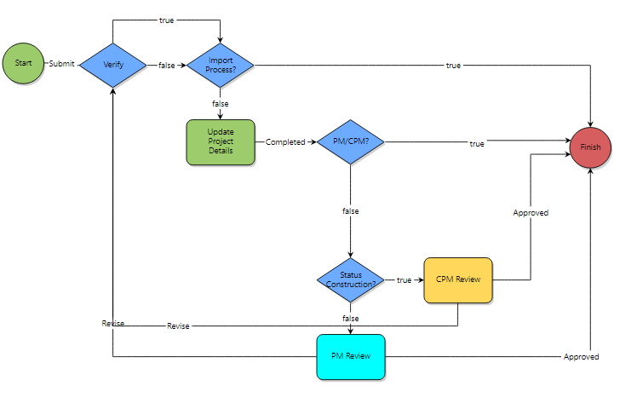
01.10 – Project Status and Details Update (PJTUP)
PJTUP - Workflow Details
Description: This process will allow updates to be made to reflect the current project details or project status throughout the life of a project. Initiators: This process can be initiated by all roles. Actors: Project Manager, Project Coordinator, and Construction Project Manager
Conditionals used by eBuilder Admin for importing data
Continued

Slide 5
01.10 – Project Status and Details Update (PJTUP)
Process Steps |  | Roles | Page Layout Sections
1 | Start Process | All Roles | Complete the required fields and submit the process.
2 | Update Project Details | All Roles | The process page layout will present you with the current values of the Project Details. There are no required fields, so make the necessary updates. Take Action “Completed” to move to the PM/CPM? conditional step.
3 | PM/CPM? | Conditional | This will determine if the PM or CPM initiated the process, in which case if “True,” will apply the update(s) and Finish. If “False,” will route to Status Construction Conditional step.
3 | Status Construction? | Conditional | This will check the project status. If it is Construction or Construction Close the process will route to CPM Review step. For any other project status, it will route the process to the PM Review step.
4 | PM and CPM Review | PM / CPM | Review all sections and either approve or send back for revision. Take Action - “Approved” to Finish or “Revise” will send back to the Initiator step. Revise will require comments to be added for the initiator.
5 | Finish | Automated | This process is now complete, and the Project Details will be updated.
The initiation/start step is used to determine the role of the initiator and to allow the process to populate data from the project details.
Note: The only field that cannot be updated by this process is the Project Photo. You will have to contact eBuilder Admin to do this.
Continued

Slide 6
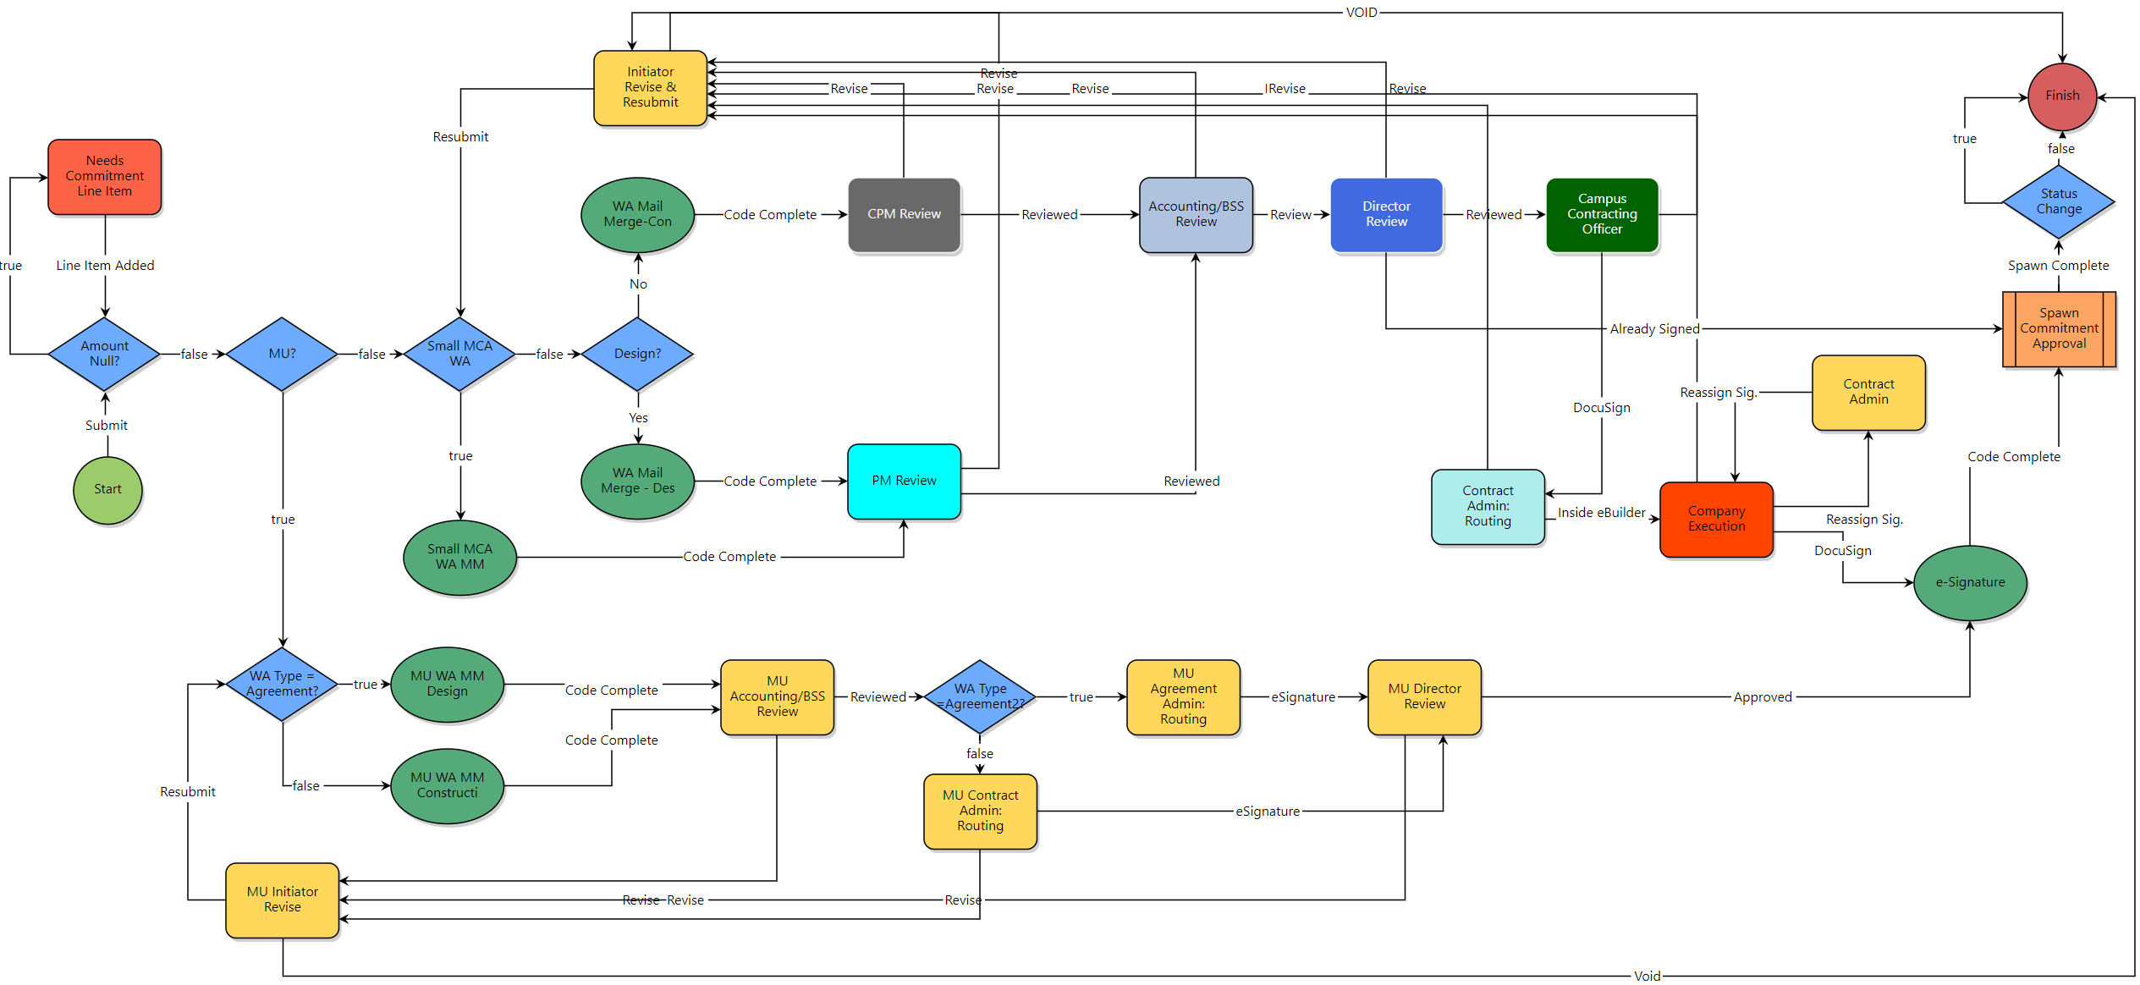
10.20 – Work Authorizations (WA)
WA - Workflow Details (Design and Labor Blankets, and MCA WA <$75k)
Description: This Process used to route a work authorization for review, approval, and final execution. Work Authorizations are typically assigned to a blanket agreements, contracts, or Master Construction Agreements (MCA). Initiators: PC, PM, CPM, Agreement and Contract Admins, Accounting/BSS, and Construction Director Actors: PC, PM, Agreement and Contract Admins, Accounting, Director of PDC, Campus Contracting Officer, and Consultant or Contractor.
Continued

Slide 7
10.20 – Work Authorizations (WA)
Process Steps |  | Roles | Page Layout Sections
0 | Pre-work | PC, PM, CPM, and Agreement and Contract Admins | Obtain a proposal for the work authorization.
1 | Start Process | Accounting/BSS, Agreement Admin, Contract Admin, CPM, PC, and PM | Complete the required fields and add any additional information you may have: Commitment Details Commitment Others Commitment Custom Fields Commitment Items Using the Add New Commitment Item – add necessary PCS line items and attach the proposal. Master Construction Work Authorization Fields Company Information Exhibit B – Unit Price Hourly Rates Supplier Diversity Participation Take Action “Submit” to send to the next step in the workflow or “Save Draft” to complete later.
2 | Amount Null? | Conditional | “True” will route to Needs Commitment Line Item step and route to Initiator to add. “False” will route to conditional MU?
3 | MU? | Conditional | “True” will route to conditional WA Type = Agreement? (For MU Campus WA’s) “False” will route to conditional Small MCA WA (For all other Campuses)
3 | Small MCA Work Authorization? | Conditional | “True” will send to Small MCA WA MM (Master Construction Agreement Work Authorization Mail Merge) “False” will send to Conditional step Design?
4 | Small MCA MM | Automated | Merge process data with Small MCA WA template and route to PM Review step.
5 | Design? | Conditional | “True” will route to WA Mail Merge – Design “False” will route to WA Mail Merge – Construction
Note: Complete using information from the proposal.
Note: This condition is based on the Work Authorization Type.
Continued

Slide 8
10.20 – Work Authorizations (WA)
Process Steps |  | Roles | Page Layout Sections
6 | WA Mail Merge - Design | Automated | Merge process data with WA template and route to Accounting/BSS Review step.
7 | WA Mail Merge - Construction | Automated | Merge process data with WA template and route to Accounting/BSS Review step.
8 | Accounting/BSS Review | Accounting/BSS | Review the mail merged document, attached proposal, comments to ensure the data for the work authorization is accurate. Review project MoCode(s) - add or correct if necessary. Take Action “Reviewed” to send to the next step in the workflow or “Revise” to send it back to the Initiator to revise.
9 | Director Review | Director | Review the mail merged document, attached proposal and comments to ensure the work authorization is accurate. Take Action “DocuSign (MU)” will apply electronic signature to work authorization and will send to Contract Admin: Routing step to prepare for vendor signature. All other campuses – Take Action “Reviewed” to send to the next step in the workflow or for all campuses -“Revise” to send it back to the Initiator to revise.
10 | Campus Contracting Officer | Campus Contracting Officer | Review the mail merged document, attached proposal and comments to ensure the work authorization is accurate. Take Action “DocuSign” to send to the next step in the workflow or “Revise” to send it back to the Initiator to revise.
12 | Contract Admin: Routing | Agreement or Contract Administrator | DocuSign preparation for vendor execution. Take Action “Inside eBuilder” to send to the vendor for execution or “Revise” to send it back to the Initiator Revise step to revise.
13 | Company Execution | Consultant or Contractor | To execute work authorization Take Action “DocuSign” to send to execute WA or “Revise Request” to send it back to the Initiator to revise.
14 | E-Signature | Automated | This step will add an executed copy of the WA to the project document library and email a copy to the consultant or contractor.
15 | Spawn Commitment Approval | Automated | This process performs the integration with PS. It will send commitment data to PS to create the PO. Then in return, PS will send the PO information back to the project and process.
16 | Change Status | Conditional | When the integration is complete the process status will be updated to “Void.” This is required to eliminate double entry in the project budget that would occur if both the process and integration return information were entered into the commitment.
17 | Finish | Automated | Update WA process instance State to “Closed.”
Continued

Slide 9
10.20 – Work Authorizations (WA)
Process Steps |  | Roles | Page Layout Sections
15 | WA Type=Agreement? | Conditional | “True” will route to MU WA MM – Design “False” will route to MU WA MM – Construction
16 | MU WA MM - Design | Automated | Merge process data with MU Design WA template and route to Accounting/BSS Review step.
17 | WA Mail Merge - Construction | Automated | Merge process data with MU WA Construction template and route to Accounting/BSS Review step.
18 | MU Accounting/BSS Review | Accounting/BSS | Review the mail merged document, attached proposal, comments to ensure the data for the work authorization is accurate. Review project MoCode(s) - add or correct if necessary. Take Action “Reviewed” to send to the next step in the workflow or “Revise” to send it back to the Initiator to revise.
19 | WA Type=Agreement2? | Conditional | “True” will route to MU Agreement Admin: Routing step “False” will route to MU Contract Admin: Routing step
20 | MU Agreement/Contract Admin: Routing | Agreement or Contract Administrator | DocuSign preparation for Director execution. Take Action “eSignature” to route to Director for execution or “Revise” to send it back to the Initiator Revise step to revise.
21 | Director Review | Director | Review the mail merged document, attached proposal and comments to ensure the work authorization is accurate. Take Action “Approved” will apply electronic signature to work authorization and will send to e-Signature automated step, "Revise” to send it back to the Initiator to revise.
22 | E-Signature | Automated | This step will add an executed copy of the WA to the project document library and email a copy to the consultant or contractor.
23 | Spawn Commitment Approval | Automated | This process performs the integration with PS. It will send commitment data to PS to create the PO. Then in return, PS will send the PO information back to the project and process.
24 | Change Status | Conditional | When the integration is complete the process status will be updated to “Void.” This is required to eliminate double entry in the project budget that would occur if both the process and integration return information were entered into the commitment.
25 | Finish | Automated | Update WA process instance State to “Void.”
Continued

Slide 10
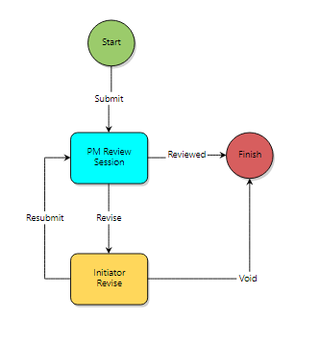
Design Reviews
Workflow Details - Description
Description: Process to upload SD, DD, %CD and CD Design Phase documents (study drawings, documents and other media that illustrate design concepts), file into eBuilder, and submit to the PM for review and distribution to campus stake holders. Initiator: Anyone that is a participant on the project Actors: PM, UM System (FPD Review / Director), Consultant
40.20 – Schematic Design Review
All Design Review Process
SD | 40.20 – Schematic Design Review
DD | 40.30 – Development Design Review
%CD | 40.35 - % Construction Design Review
CD | 40.40 – Construction Design Review
Continued

Slide 11
Design Reviews
Process Steps |  | Roles | Page Layout Sections
1 | Start/Initiate | Consultant | Consultant will initiate the process and attach relevant documents for the review phase. They will click Submit, which will initiate the process and route to the Project Manager. They can also click on Save Draft, to save and work later.
2 | PM Review Session | Project Manager | PM reviews all documents for approval or return to Initiator. Take Action “Reviewed” will go to finish and close the process, “Revise” will route back to initiator and will require you to add comments.
3 | Finish | Automated | Process state will be updated to Complete.
Note: Bluebeam Review sessions can be scheduled as needed.
Continued

Slide 12
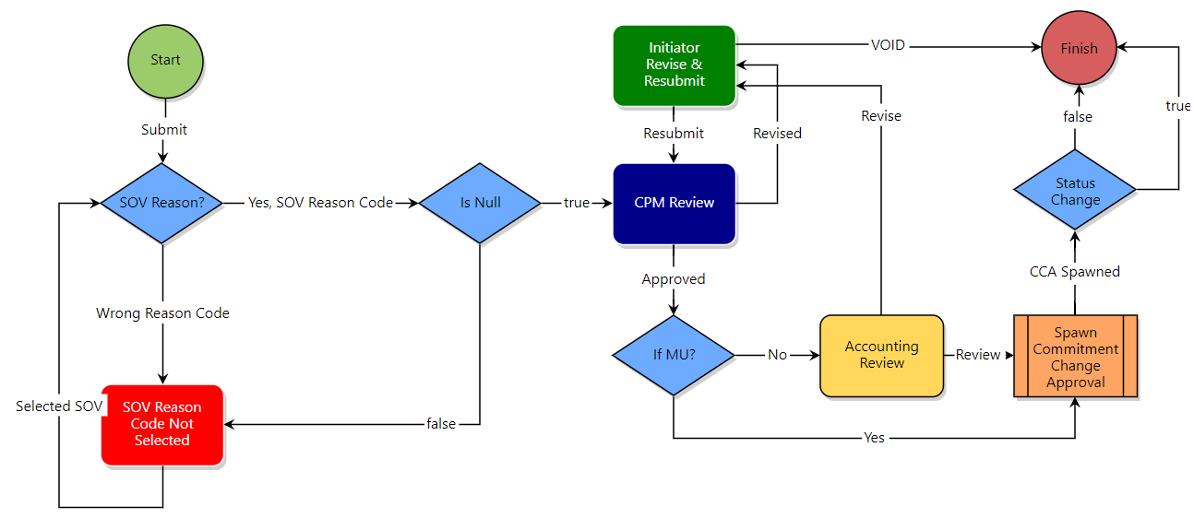
10.50 – Schedule of Values (SOV)
Note: While GCs have the permissions to initiate this process, most campuses prefer to do this in-house. They will have the GC provide their SOVs in a spreadsheet, then an admin or CPM will initiate this process and import SOVs.
Prerequisite: Required to have an approved construction contract. This process will expand the PCS line-item 2000 Base Bide.
SOV - Workflow Details
Description: Process to establish the Schedule of Values. Initiators/Actors: CPM, Contract Administrator, Accounting, Director of PDC, Construction Director and General Contractors
Continued

Slide 13
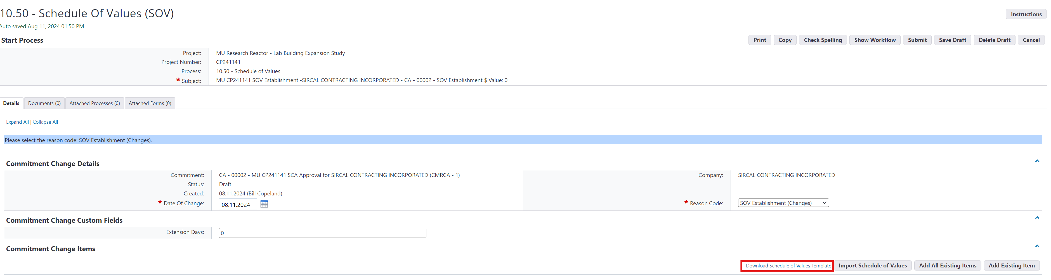
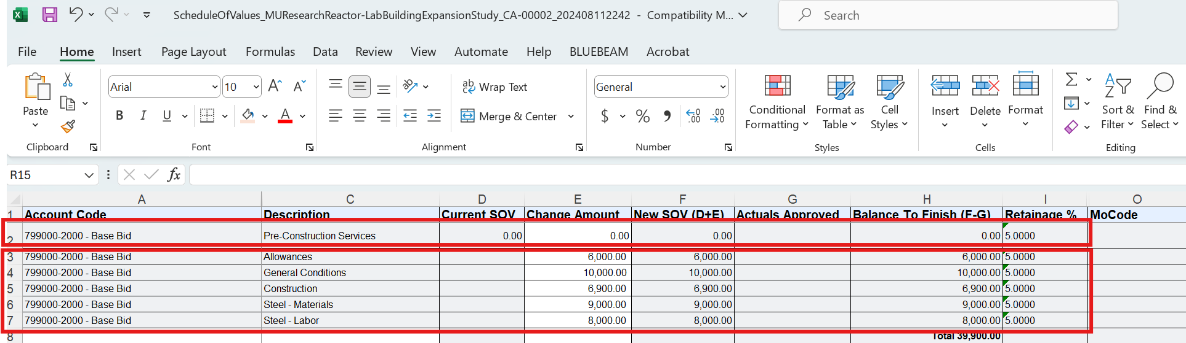
10.05 – Schedule of Values (SOV)
You can add SOV manually or through an import process
The original base bid or Current SOV needs to be zeroed “0” out.
The newly added SOVs need to equal the original base bid amount.
Continued

Slide 14
10.05 – Schedule of Values (SOV)
Process Steps |  | Roles | Page Layout Sections
0 | Pre-work | CPM/Admin | Create import spreadsheet. The first line needs to offset the total. Example: Base Bid $789,000, the first line of the SOV is required to be - $789,000 and then the SOV line items will total to the same amount which will result in a $0 net change.
1 | Start Process | CPM, Contract Admin, Accounting, Directors, and GCs | Complete the required fields in the following sections: Select the commitment (contract) Select the Date Select the Reason Code “SOV Establishment” Click on “Submit” button to initiate the process or click “Save Draft” button to save and finish later.
2 | SOV Reason? | Conditional | Checking to ensure “SOV Establishment” reason code was selected. If not, it will route back to initiator with an error message.
3 | Is Null? | Conditional | Checking to ensure the commitment change amount = $0. If not, it will route back to initiator to correct.
4 | CPM Review | CPM | Review SOVs for general contractor billing. Ensure all information is accurate. Take Action “Approved” to move to the next step “Revise” to send back to the Initiator step.
5 | If MU? | Conditional | “Yes” will bypass the Accounting Review step and send to Commitment Change Approval step. “No” will route to Accounting Review step for all other campuses.
6 | Accounting Review (UMKC, UMSL and S&T) | Director of FPD | Review all sections and check SOV line-item project MoCodes. Take Action “Reviewed” to move to the Commitment Change Approval step, or “Revise” to send back to the Initiator step.
7 | Commitment Change Approval | Spawned | This spawned process will integrate with PeopleSoft to establish the SOVS in the PO. When completed, the PO will also update the construction commitment Base-bid line with SOVs.
8 | Status Change | Conditional | This will change the status of the SOV process in eBuilder to “Void.” This is required to eliminate the duplication of SOV amounts in eBuilder by the process and by the integration with PeopleSoft.
9 | Finish | Automated | This process is now complete, and the budget PCS summary will be updated.
Continued

Slide 15
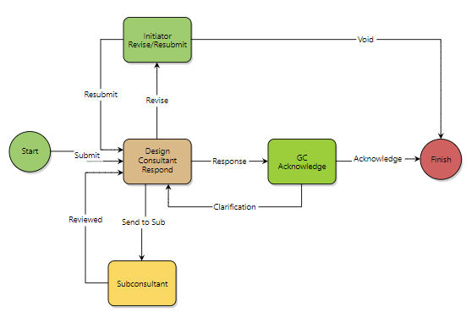
50.10 - Request for Information (RFI)
RFI - Workflow Details
Description: Process for the General Contractor/CMR to submit questions, issues or any clarifications of project documents. Initiators/Actors: Project Manager, Contract Admin, Accounting, Director of PDC, Campus Contracting Officer, UM System (FPD Review / Director), Consultant
Continued

Slide 16
50.10 - Request for Information (RFI)
Process Steps |  | Roles | Page Layout Sections
1 | Start/Initiate | CPM, Director, PM, GCs, | Complete the required fields and any other additional fields: Category: Clarification/Design Question/Clarification?: Proposed Solution: Click Submit, which will initiate the process and route to the Design Consultant Respond step; or click Save Draft, to save and work later.
2 | Design Consultant Respond | Design Staff | Design Consultant reviews the RFI and can either respond, forward to a sub or send back to Initiator. Take Action “Response” will route to the GC Acknowledge step, “Send to Sub” to get additional input from Sub, and “Revise” will route back to initiator and will require you to add comments.
3 | Subconsultant | Design Staff | Sub will review and respond to RFI. Take Action “Reviewed” will route back to the Design Consultant Respond step.
 | GC Acknowledge | General Contractor | GC will review the RFI and clarification and will determine if this RFI will impact Schedule and/or Cost. Take Action “Acknowledge” will route to the Finish step and “Clarification” route back to the Design Consultant Respond step.
3 | Finish | Automated | Process Status will update to “Finish” and the Process State will be updated to “Complete.”
Continued

Slide 17
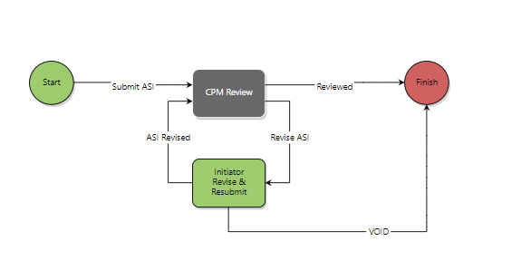
50.20 – Architectural Supplement Instruction
ASI- Workflow Details
Description: An ASI is the Architect or Engineer's "Supplemental Instruction" in response to an RFI or used by the designer to transmit clarifications or changes to the scope of the work. This work is to be implemented by the contractor. The contractor should note that the issuance of an ASI or ESI may or may not result in a Change Order. Initiators/Actors: CPM, Design Staff, Consultant Admin, Design Consultant
Continued

Slide 18
50.20 – Architectural Supplement Instruction
Process Steps |  | Roles | Page Layout Sections
1 | Start/Initiate | Design Staff, Consultant Admin, or Design Consultant | Complete the description field and attach any relevant documentation. Click Submit, which will initiate the process and route to the CPM Review step; or click Save Draft, to save and finish later.
2 | CPM Review | CPM | CPM reviews the ASI and can either respond to the initiator with questions for additional clarification or take the action Reviewed to finish the process. In addition, if there was an RFI process that initiated the ASI, attach the RFI process in the process tab of the page layout. Take Action “Reviewed” will route to the Finish step, “Revise ASI” to get additional input from the initiator
3 | Finish | Automated | Process Status will update to “Finish” and the Process State will be updated to “Complete.”
Continued

Slide 19
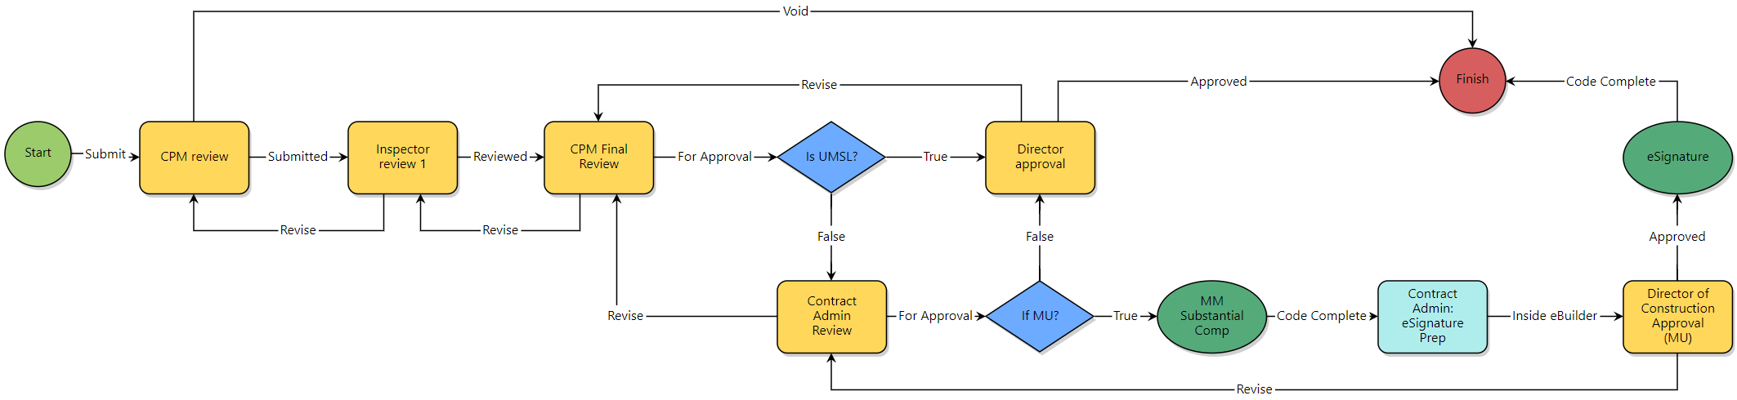
60.05 – Substantial Completion Acceptance Process
SubCa- Workflow Details
Description: This process is used to initiate and route the Substantial Completion acceptance request to the Director for approval. It contains checklists for all required contract and code documentation, allows the inspector to determine certificate of occupancy and permit close out requirements, and provides document attachments for Contract Admin and Director review and approval. Initiators/Actors: CPM, Construction Director, Campus Code Reviewer, Contract Admin, Inspector, Owners Agent and PM
Continued

Slide 20
60.05 – Substantial Completion Acceptance Process
Process Steps |  | Roles | Page Layout Sections
1 | Start Process | CPM, Directors, Campus Code Reviewer, Contract Admin, Inspector, Owners Agent and PM | Complete the required fields in the following sections: Select the commitment (contract) Select the Date Select the Reason Code “SOV Establishment” Click on “Submit” button to initiate the process or click “Save Draft” button to save and finish later.
2 | CPM Review |  | Checking to ensure “SOV Establishment” reason code was selected. If not, it will route back to initiator with an error message.
3 | Inspector Review 1 |  | Checking to ensure the commitment change amount = $0. If not, it will route back to initiator to correct.
4 | CPM Final Review | CPM | Review SOVs for general contractor billing. Ensure all information is accurate. Take Action “Approved” to move to the next step “Revise” to send back to the Initiator step.
5 | Is UMSL? | Conditional | “Yes” will bypass the Accounting Review step and send to Commitment Change Approval step. “No” will route to Accounting Review step for all other campuses.
6 | Contract Admin Review |  | Review all sections and check SOV line-item project MoCodes. Take Action “Reviewed” to move to the Commitment Change Approval step, or “Revise” to send back to the Initiator step.
7 | If MU? | Conditional | This spawned process will integrate with PeopleSoft to establish the SOVS in the PO. When completed, the PO will also update the construction commitment Base-bid line with SOVs.
8 | MM Substantial Comp | Automated | This will change the status of the SOV process in eBuilder to “Void.” This is required to eliminate the duplication of SOV amounts in eBuilder by the process and by the integration with PeopleSoft.
9 | Contract Admin: eSignature Prep | Contract Admin
10 | Director of
 | Finish | Automated | This process is now complete, and the budget PCS summary will be updated.
Continued

Slide 21
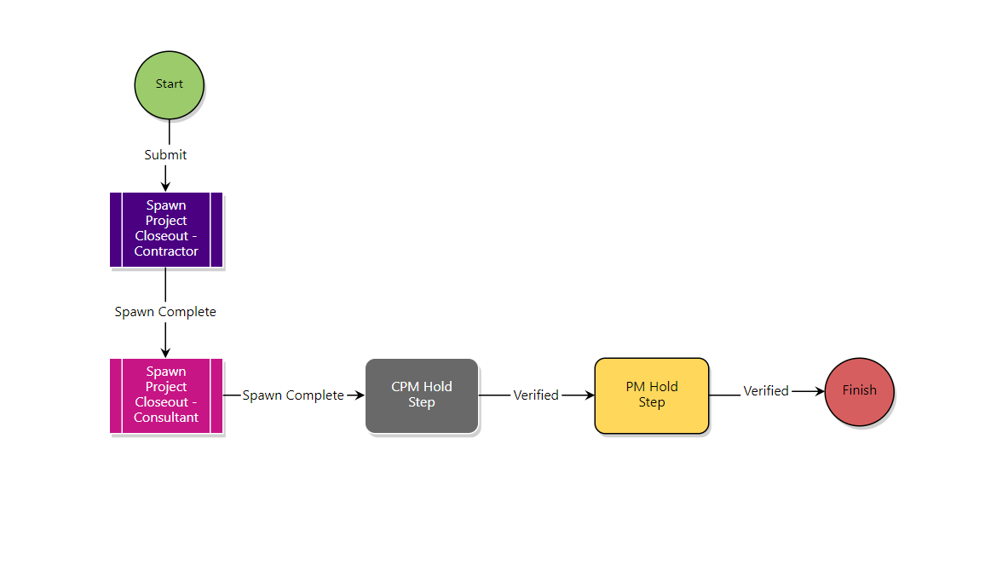
60.10 – Project Closeout
DBB - Workflow Details
Description: This is the parent process that initiates the Project Closeout and spawns the Consultant and Contractor Closeout subprocesses, linking them together. Actors: PM, CPM, Contract Admin, Director of PDC, Campus Contracting Officer, UM System (FPD Review / Director), General Contractor.
Subprocesses
60.20
60.30
Continued

Slide 22
50.20 – Architectural Supplement Instruction
Process Steps |  | Roles | Page Layout Sections
1 | Start/Initiate | Design Staff, Consultant Admin, or Design Consultant | Complete the description field and attach any relevant documentation. Click Submit, which will initiate the process and route to the CPM Review step; or click Save Draft, to save and finish later.
2 | CPM Review | CPM | CPM reviews the ASI and can either respond to the initiator with questions for additional clarification or take the action Reviewed to finish the process. In addition, if there was an RFI process that initiated the ASI, attach the RFI process in the process tab of the page layout. Take Action “Reviewed” will route to the Finish step, “Revise ASI” to get additional input from the initiator
3 | Finish | Automated | Process Status will update to “Finish” and the Process State will be updated to “Complete.”
Continued

Slide 23
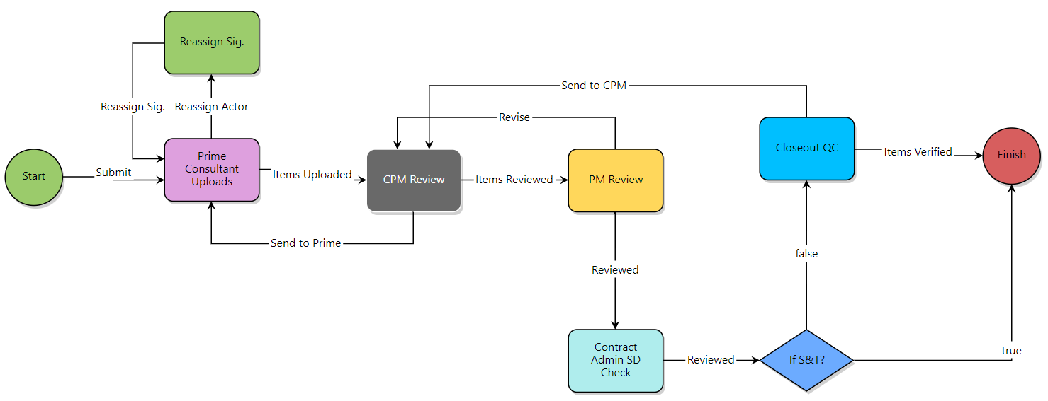
60.20 – Project Closeout - Consultant
PRJCN – Project Closeout - Consultant
Description: This is a child process of the Project Closeout process for the consultant. Actors: Consultants, PM, CPM, and Contract Admin
Continued

Slide 24
60.20 – Project Closeout - Consultant
Process Steps |  | Roles | Page Layout Sections
1 | Start/Initiate | Construction Director, CPM, Director, PM and Contract Admin | Complete the required fields in the following sections of the start page layout: Commitment Details Commitment Others Commitment Custom Fields Commitment Items Once completed, click “Submit” or “Save Draft” to complete later.
2 | Amount Null? | Conditional | If the amount is null, the process will be returned to the Initiator step with an error message to correct.
3 | Construction Services Manager | Construction Director | Review attached proposal and compare it to the information entered in the process page layout. Take Action: “Reviewed” to send to the next step in the workflow or “Revise Request” to send it back to the Initiator.
4 | Accounting/BSS Review | Accounting/BSS | Verify the appropriate MoCode has been applied. Take Action: “Reviewed” to send to the next step in the workflow or “Revise” to send it back to the Initiator to revise.
5 | Director | Conditional | “Yes” route to CPM Review Construction (Allowance) “No” route to CPM Review (Const.) Allows the CPM to include the GC in the workflow.
6 | Contract Signing Limits | Conditional | “Yes” route to MM with CL “No” route to MM with No Cl
7 | Mail Merge with CL (System) | Automated | Performs mail merge of process data with DBB contract template and routes to Mail Merge for Bonds System.
8 | Mail Merge for Bonds System | Automated | This step will merge process data with the Change Order template and create the Change Order and attach it to the process for the next review step.
9 | Campus Contracting Officer and System Review | Contracting Officer Campus/System | Review attached proposal and compare it to the information entered in the process page layout. Take Action: “Reviewed” to send to the next step in the workflow or “Revise Request” to send it back to the Initiator.
Continued

Slide 25
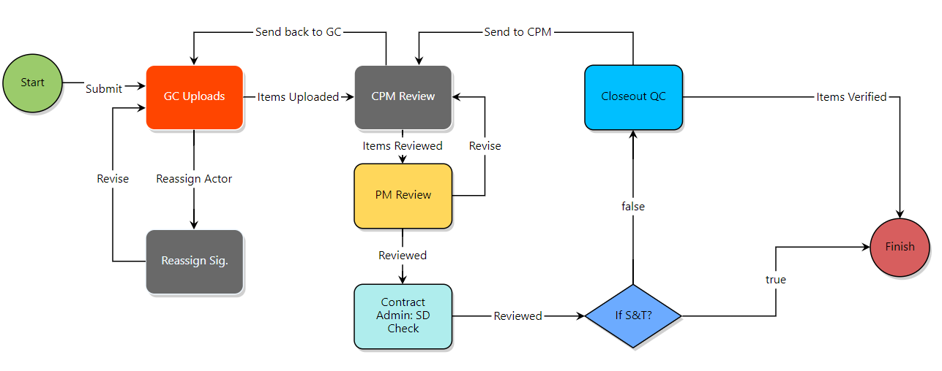
60.30 – Project Closeout - Contractor
PRJCl – Project Closeout - Contractor
Description: This is a child process of the Project Closeout process for the contractor. Actors: Consultants, PM, CPM, and Contract Admin
Continued

Slide 26
60.30 – Project Closeout - Contractor
Process Steps |  | Roles | Page Layout Sections
1 | Start | Spawned | This process is initiated/spawned from the 60.10 – Project Closeout proccess
2 | GC Uploads | General Contractor | Review attached proposed Change Order. Take Action: “Reviewed” to send to the next step in the workflow or “Revise” to send it back to the Initiator, or “Send to Contractor.”
3 | CPM Review | CPM | “Yes” System Review (Const.) step. “No” route to CO Approver (Const.) step.
4 | PM Review | FPD Contract Admin | Review contractor’s signed contract. Take Action: “Reviewed” to send to the next step.
5 | Contract Admin: SD Check |  | Execute Contract. Take Action: “DocuSign” to execute contract and route to next step.
6 | If S&T? | Conditional | Execute Contract. Take Action: “DocuSign” to execute contract and route to next step.
7 | Finish | Automated | Completed.
Continued

Slide 27
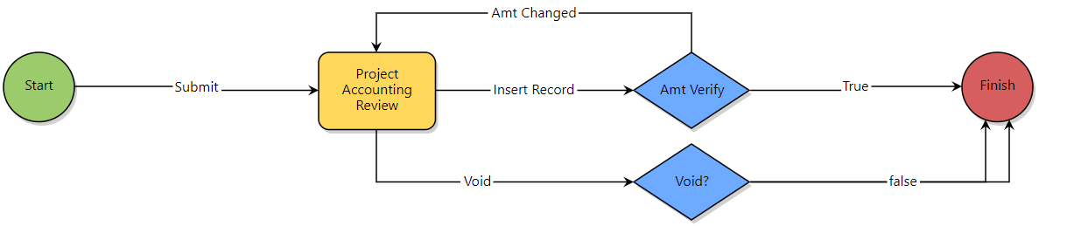
80.00 - Admin – Cost Process Exceptions Import
CEI – Cost Process Exceptions Import
Description: This is a child process of the Project Closeout process for the contractor. Actors: Consultants, PM, CPM, and Contract Admin
Continued

Slide 28
80.00 - Admin – Cost Process Exceptions Import
Process Steps |  | Roles | Page Layout Sections
1 | Start | Spawned | This process is initiated/spawned from the 60.10 – Project Closeout proccess
2 | GC Uploads | General Contractor | Review attached proposed Change Order. Take Action: “Reviewed” to send to the next step in the workflow or “Revise” to send it back to the Initiator, or “Send to Contractor.”
3 | CPM Review | CPM | “Yes” System Review (Const.) step. “No” route to CO Approver (Const.) step.
4 | PM Review | FPD Contract Admin | Review contractor’s signed contract. Take Action: “Reviewed” to send to the next step.
5 | Contract Admin: SD Check |  | Execute Contract. Take Action: “DocuSign” to execute contract and route to next step.
6 | If S&T? | Conditional | Execute Contract. Take Action: “DocuSign” to execute contract and route to next step.
7 | Finish | Automated | Completed.
Continued

Slide 29
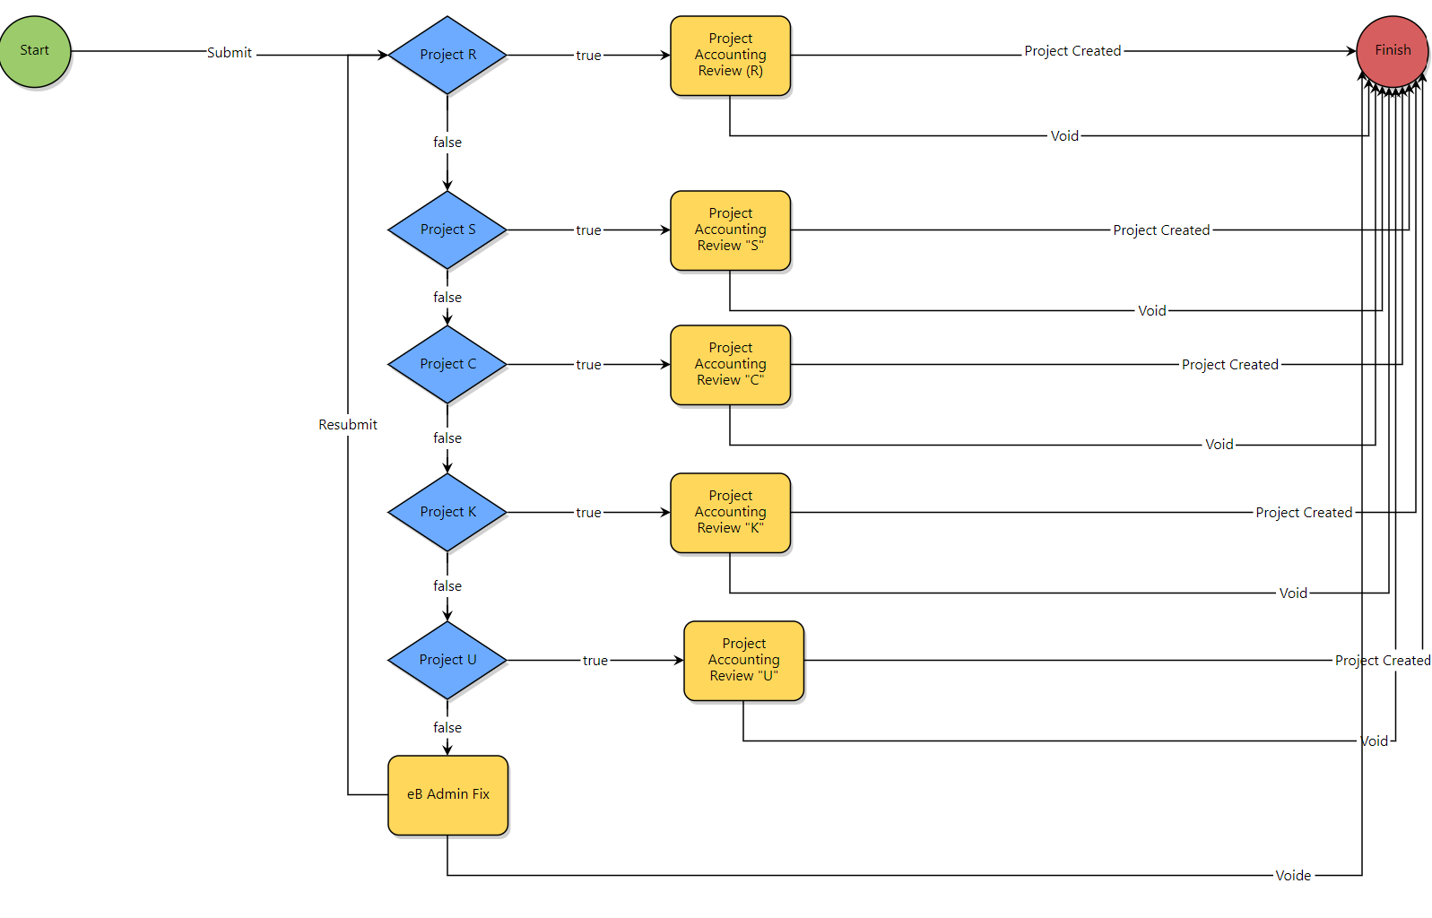
80.10 - Admin – Non- Cost Process Exceptions Import
N-CEI – Cost Process Exceptions Import
Description: This is an admin project to determine if the expense incurred requires a project to be added to eBuilder. Actors: eBuilder Admin
Continued

Slide 30
60.30 – Project Closeout - Contractor
Process Steps |  | Roles | Page Layout Sections
1 | Start | Spawned | This process is initiated/spawned from the 60.10 – Project Closeout proccess
2 | GC Uploads | General Contractor | Review attached proposed Change Order. Take Action: “Reviewed” to send to the next step in the workflow or “Revise” to send it back to the Initiator, or “Send to Contractor.”
3 | CPM Review | CPM | “Yes” System Review (Const.) step. “No” route to CO Approver (Const.) step.
4 | PM Review | FPD Contract Admin | Review contractor’s signed contract. Take Action: “Reviewed” to send to the next step.
5 | Contract Admin: SD Check |  | Execute Contract. Take Action: “DocuSign” to execute contract and route to next step.
6 | If S&T? | Conditional | Execute Contract. Take Action: “DocuSign” to execute contract and route to next step.
7 | Finish | Automated | Completed.
Continued

Slide 31
The End
Questions?

