Slide 1
eBuilder Training
Cost Module - Supplement

Slide 2
Contents
Important Terms
Important Concepts
Project Cost Summary - Layout
Budget
Commitments
Actuals
Questions

Slide 3
Important Terms
Terms | Descriptions
Account Level Role | Roles, when added to, that will automatically be assumed when added as a participant to a project. Also see Project Level Roles.
Commitment | Refers to money obligated to a consultant or contractor in eBuilder. (i.e.: Agreements, Contracts, POs, etc.)
Controlling Process | The process through which cost has been implemented into the system. This is only displayed for cost-enabled processes.
Cost-enabled Process | A process that integrates with cost items such as the budget, commitments and invoices.
Initiator | A user who can start (initiate ) a workflow process instance.
Mail Merge | A step in a process that will merge data with a template to create documents such as agreements, contracts, NTPs, etc.
Project Level Roles | Roles that are configured and managed at the project. Also see Account Level Roles.
Process Instance | This provides insight to the process current state. Accessed by clicking into the process link.
Project Participants | A subcategory of Project Details that allows you to view participants and their roles on the project.
Spawned | A process step that initiates another process.
Take Action | Selecting and using the “Take Action” button in a process instance.

Slide 4
Important Concepts
95% of the interaction with project(s) will be done through workflow processes
You can only initiate a processes through a project
Processes can be initiated and acted on by internal users and external users with the correct permissions
Processes will automatically place attachments in the correct folder in the Document Module
Process statuses change throughout the process.
A SPAWNED process will initiate a new process in draft mode and will require an actor to submit it
In eBuilder a child projects are not required for multiple construction contracts
eBuilder uses controls to not allow you to go over budget or over invoice

Slide 5
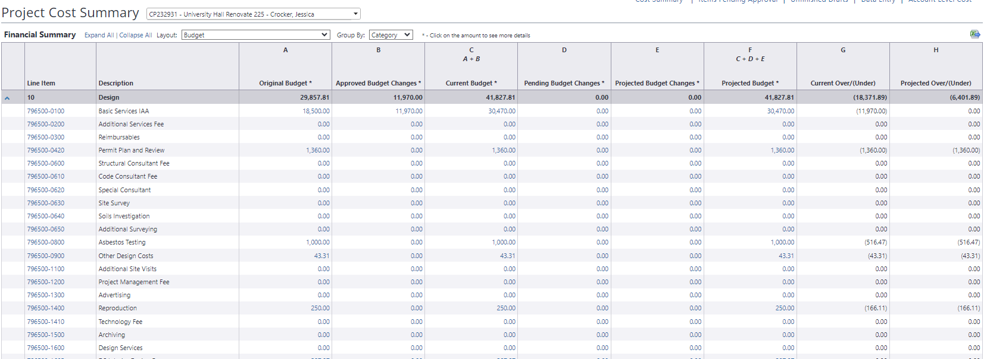
Project Cost Summary Layout
How to change your Layout in the Project Cost Summary within a project:
Select the Layout*
Select Group By – “Category” is like the PCS spreadsheet
You can export to Excel
3
1
2
*Note: The subsequent slides will include more detail on the following Layouts: Budget, Commitments, and Actuals

Slide 6
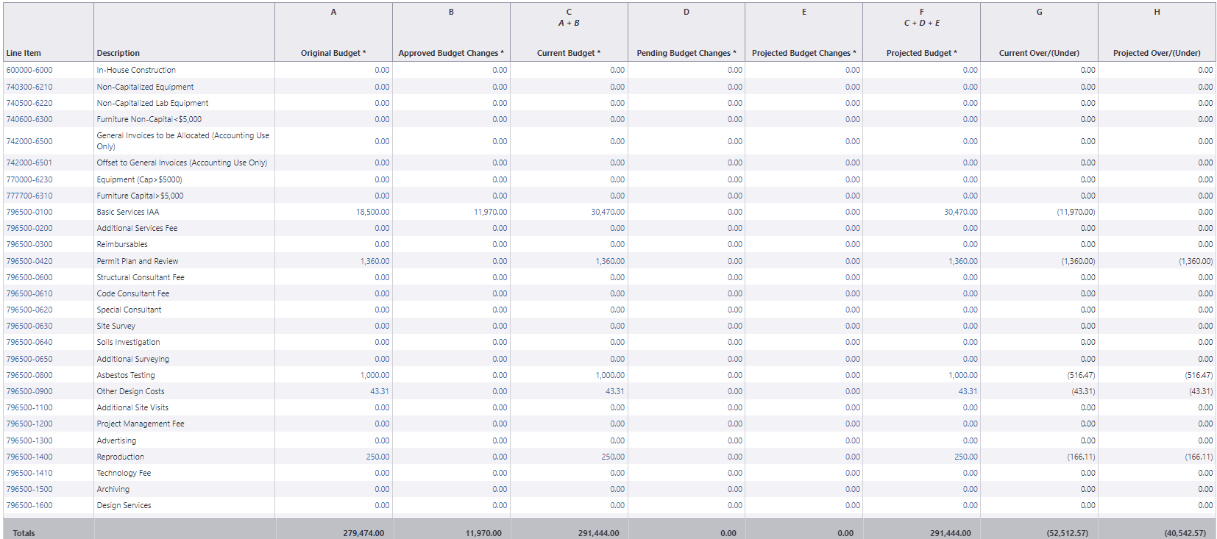
Project Cost Summary – Budget
Original Budget: This the originally approved budget amount. This figure can include budget changes to the original budget amount if the reason code “Original” is used.
Approved Budget Changes: This the amount of approved budget changes
Current Budget: This is the approved original budget and all approved changes.
Pending Budget Changes: The “Pending” usually refers to budget changes pending final approval. In a process, this status might automatically be applied in a specific step.
Projected Budget Changes: The “Projected” usually refers to budget changes that are earlier in the process. In a process, this status might automatically be applied in a specific step.
Projected Budget: This total includes the original budget amount plus all “pending,” “projected,” and “approved budget changes.”

Slide 7
Statuses for Budget Processes
Budget Processes
10.00 – Project Authorization (Budget Establishment) (PA)
10.05 – Project Budget Re-Allocation/Change (PABC)
Status = Draft
Status = Projected
Status = Pending
Status = Approved
Continued

Slide 8
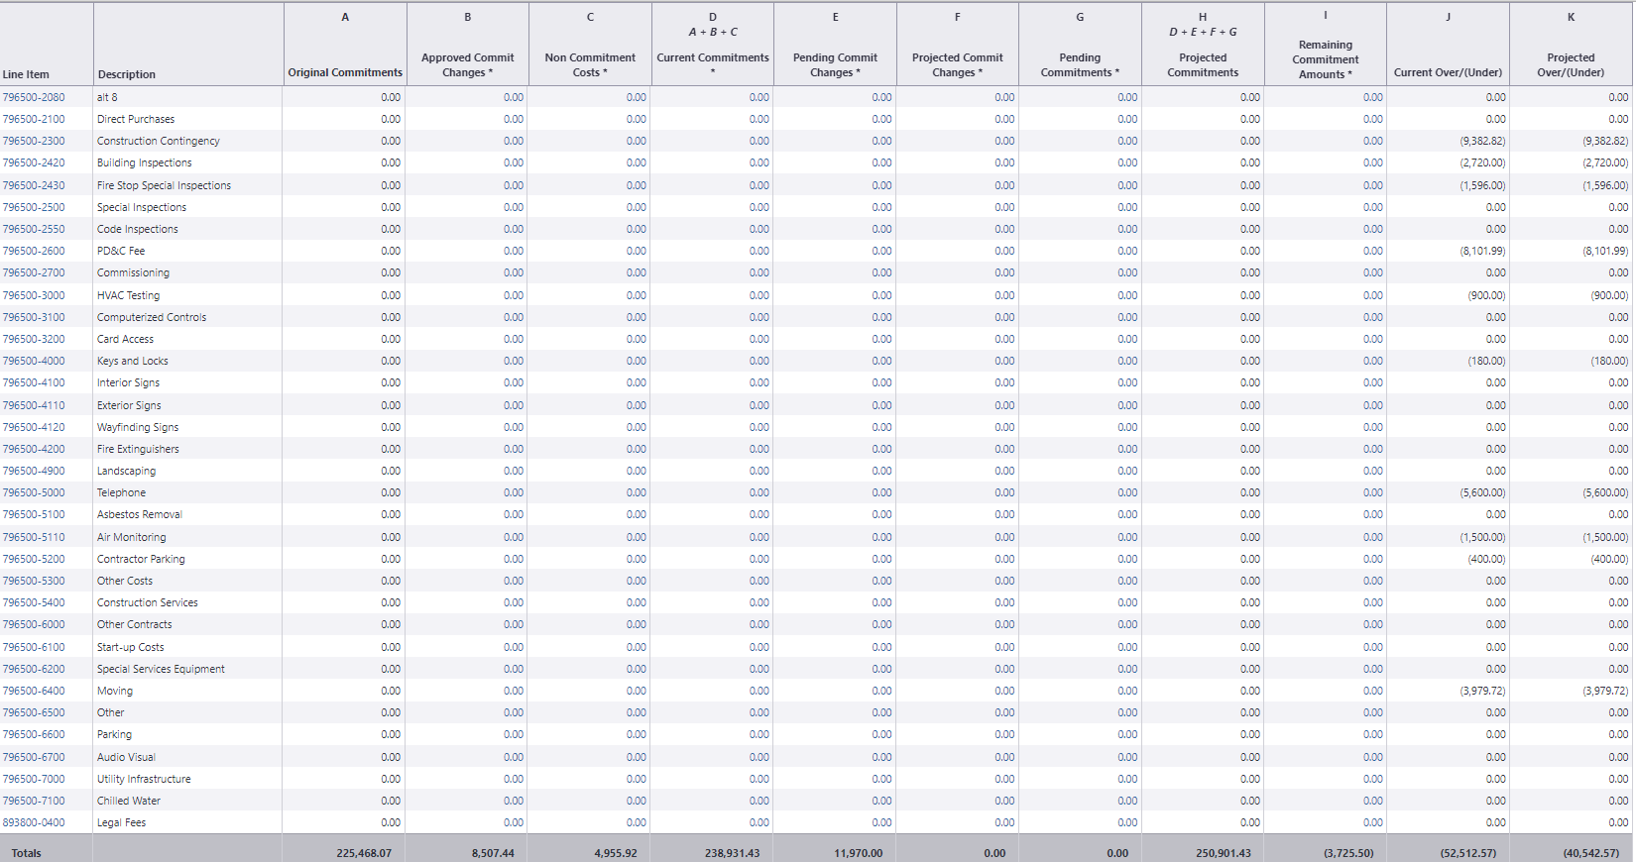
Project Cost Summary - Commitments
Original Commitment: This is the amount of all approved commitments. This can include commitment changes against the original commitment value.
Approved Commitment Changes: This is the amount of all approved changes to the original commitment.
Non-Commitment Cost: These are general invoices that originate in PeopleSoft.
Current Commitments: This is the amount of all approved commitment changes plus original commitments and approved general invoices.
Pending Commitment Changes: The “Pending” is a status is to refer to commitment changes that are pending a hard signature.
Projected Commitment Changes: The “projected” status is used to account for anticipated commitment changes.
Pending Commitment: The “Pending” is a status that usually refers to commitments that are pending a hard signature.
Projected Commitments: This is the total sum of current commitments, pending, pending changes and project changes to commitments.

Slide 9
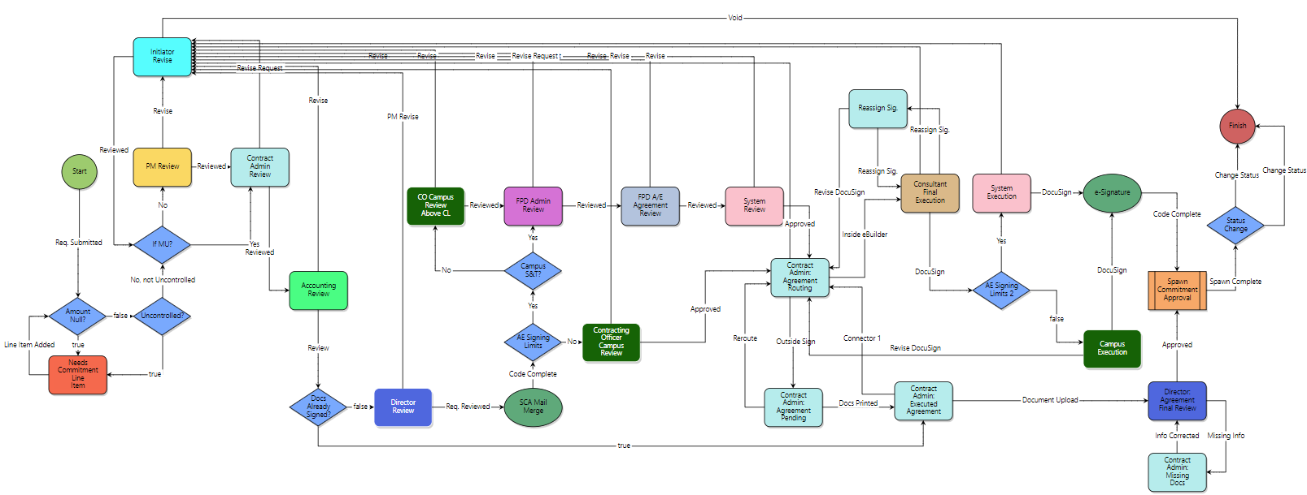
Statuses for Commitment Processes
All Commitment Types
20.10 - Standard Consultant Agreement (SCA) | 10.20 – Work Authorizations (WA)
20.30 - General Consultant Agreement (GCA ) | 30.10 – DBB Construction Contract (DBB)
20.50 - Geotechnical Engineer Agreement (GEA) | 30.30 – CMR Commitment Approval (CMRCA)
20.60 - Land Surveyor Agreement (LSA) | 30.40 – MCA Work Authorization (MCAWA )
Note: For commitments in eBuilder, we are required to change the process status to “Void” prior to the Finish step. This is to avoid a duplicate commitment amount being added to the budget in eBuilder. The final commitment amount will be added when PO is created in PS, and the final integration step sends back this information from PS.
Status = Draft
Status = Pending
Status = Void
Continued

Slide 10
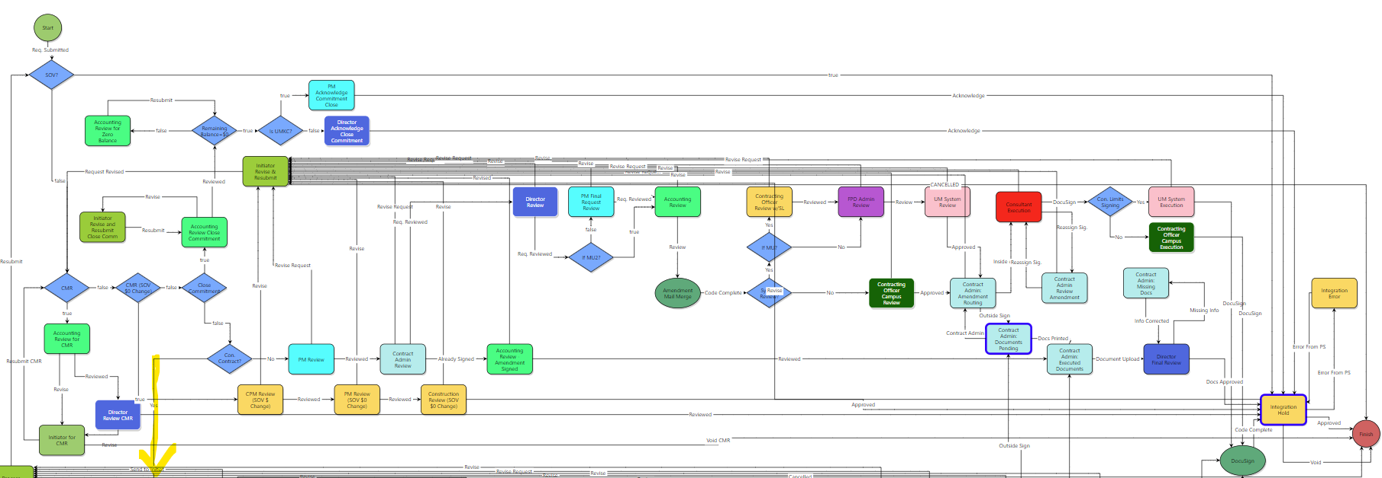
Statuses for Commitment Processes
All Commitment Amendments and Change Orders
30.14 – Change Order / Amendment Request (COAR) Standard Consultant Agreement
Note: Projected is an available status for commitment amendments and changes.
Status = Draft
Status = Projected
Status = Pending
Status = Approved
Continued

Slide 11
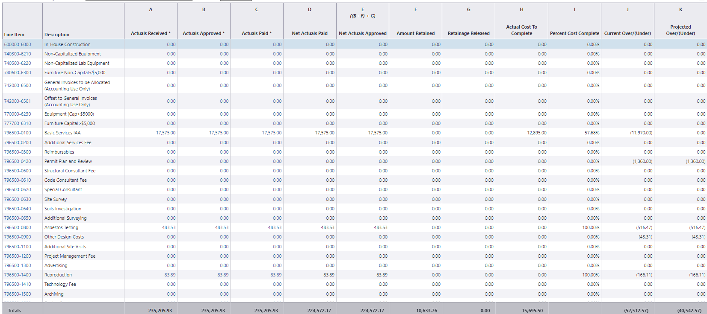
Project Cost Summary - Actuals
Actuals Received: This is the amount of all approved invoices as well as those marked with a status of “received.”
Actuals Approved: This is the total amount of invoices with status of “approved.”
Actuals Paid: The total amount of all invoices with a status of “paid.”
Net Actuals Paid: This is the amount of all invoices that have been paid, not including retainage. The formula is as follows:
paid invoices - retainage held (retainage not yet paid).
Net Actuals Approved: This is the total amount of approved invoices less retainage held (retainage not yet paid).
Amount Retained: This is the total amount being retained.
Retainage Released: This is the amount that is approved to be released.
Actual Cost to Complete: This is the total invoice amount needed to fulfill all commitments. (project commitments) – (actuals approved)
Percent Cost Complete: This is the percentage amount of the costs necessary to complete the project based on the current budget. This total is derived by dividing approved invoices by projected commitments. The formula is as follows: % = (approved invoices) / (projected commitments).

Slide 12
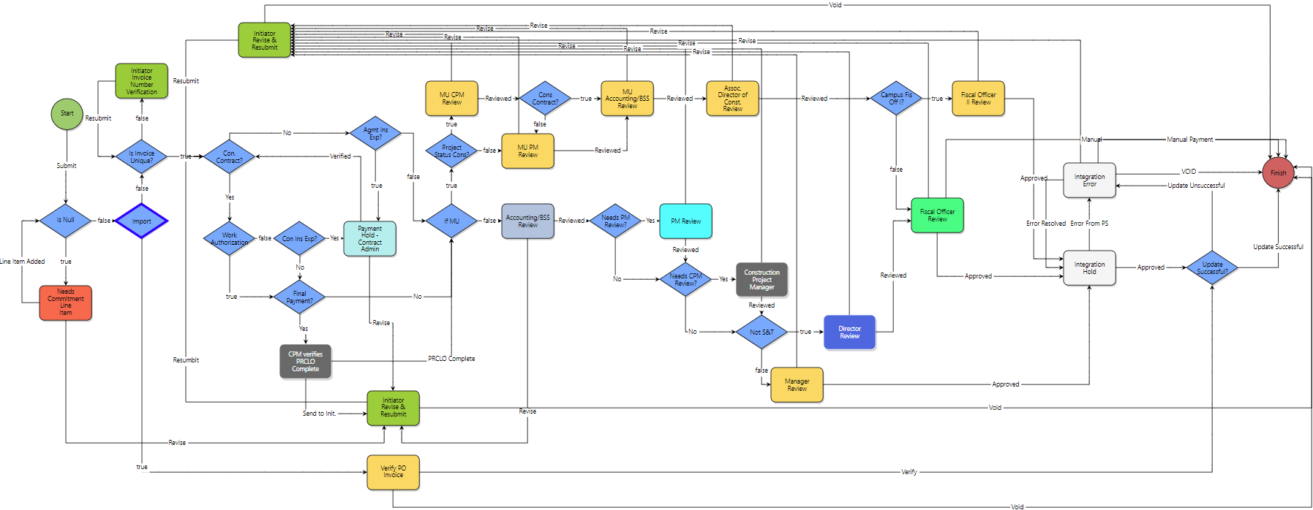
Statuses for 70.00 - Invoice Approval (INV)
Status = Draft
Status = Received
Status = Approved
Status = Paid

Slide 13
The End

