Slide 1
Submittal Training
ANTHONY DOKODI, BUSINESS ANALYST
DECEMBER 14, 2022
Notes:
This PowerPoint Template includes a series of slide masters with predefined layouts and color schemes for formatting slides
Slide Masters are displayed when you right click on a slide and select Layout from menu

Slide 2
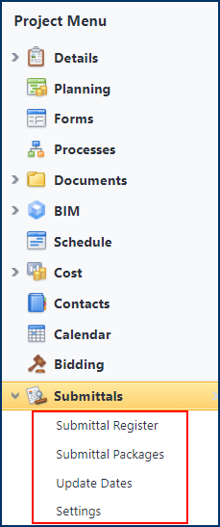
Submittals
Only accessible at the Project level.
Allows general contractors, sub-contractors, and submittal coordinators to electronically manage the submittals process and review types of materials
Both e-Builder licensed (users with login credentials) and non-licensed (external users) participants can be engaged in the submittal process and still be subject to the same visibility as any other project participant
Electronic process by which materials and installation of materials are reviewed and approved
Provides owner visibility into the submittals and their progress to ensure time is not wasted in reviewing materials
Minimizes the potential for bottlenecks.

Slide 3
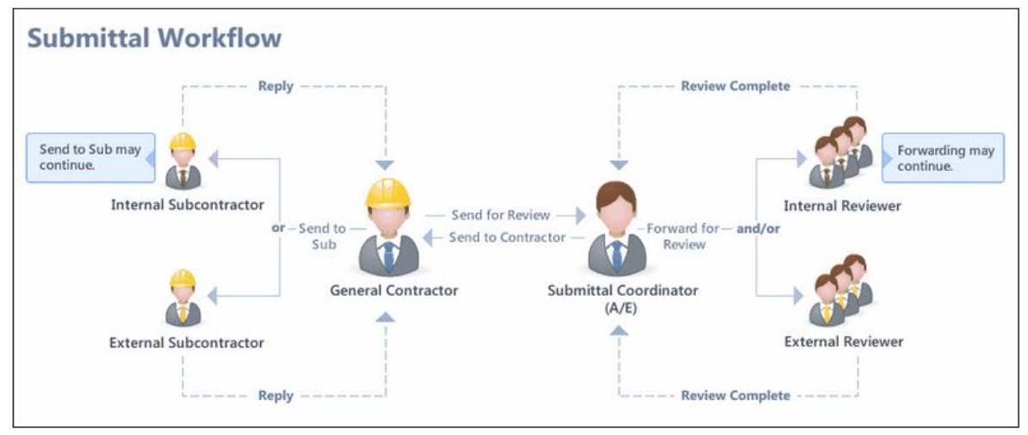
Submittals Management

Slide 4
Submittals Management
Project Settings
Submittal Register
Submittal Package
Subcontractor Options
General Contractor Options
Submittal Coordinator Options
Completing the Submittal Package

