Slide 1
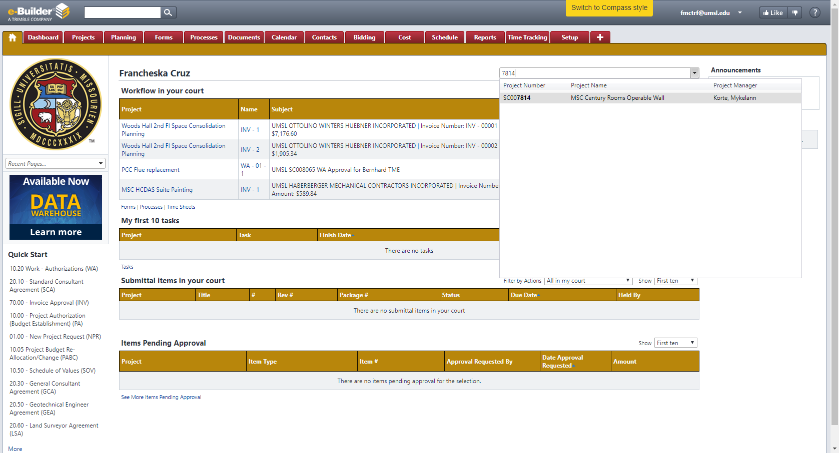
2. Use search box to find the project needed. Click on it to go to the project’s page.
1. Make sure to be in your home page.

Slide 2
Click on Project Budget

Slide 3
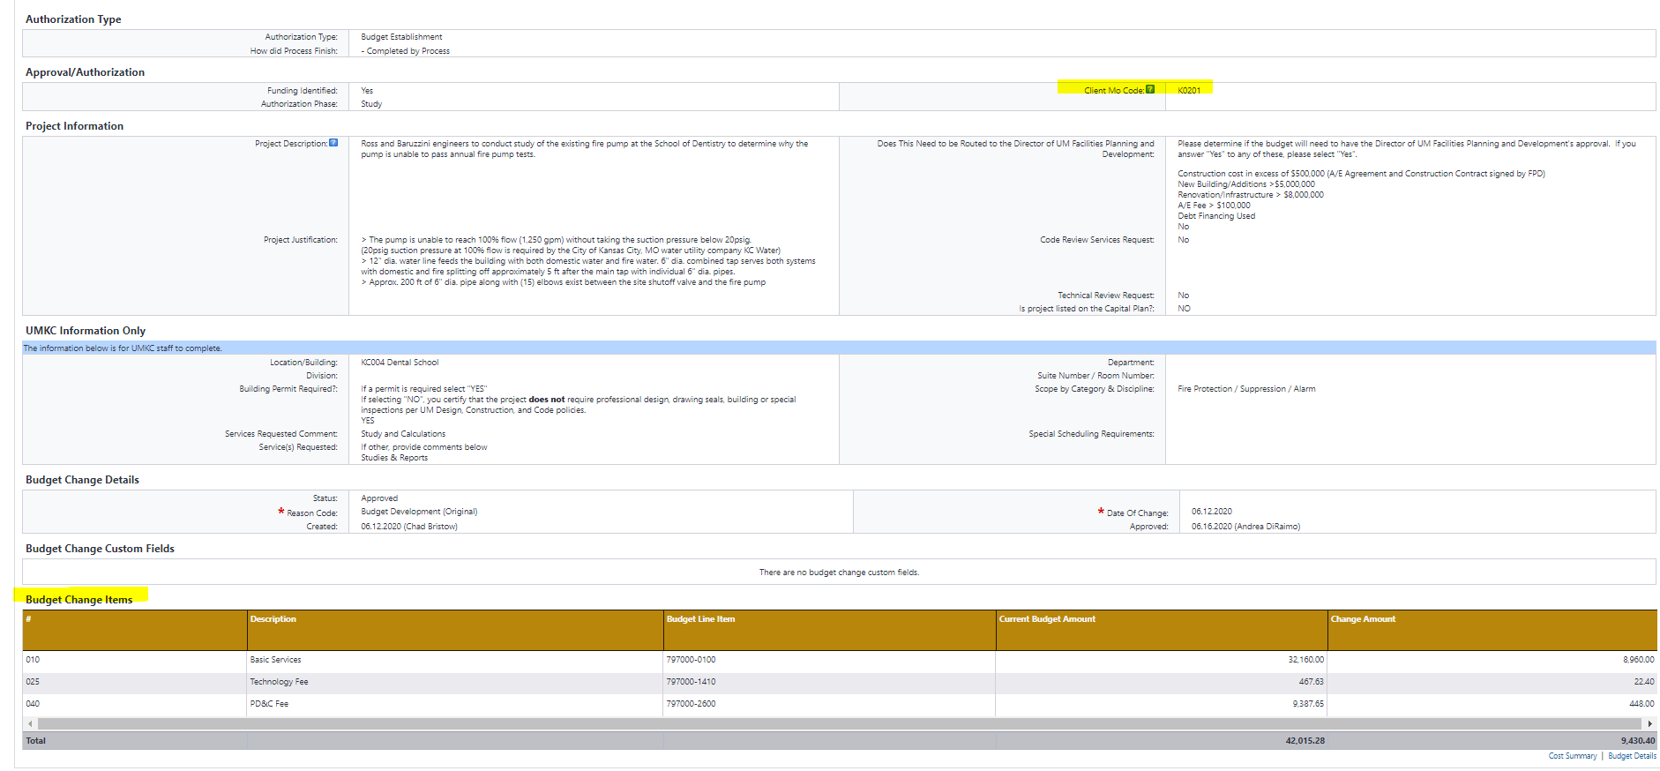
Review project Budget and enter department mocode

Slide 4
Drop Down Box
Select approve or revised and take action to complete
Budget process is complete

