Slide 1
e-Builder Overview
University of Missouri
Construction Program Management Software

Slide 2
e-Builder – Who are we?
e-Builder is a fully-integrated, owner-centric, cloud-based construction program management software (SaaS) no hardware, servers, web-based.
e-Builder helps owners manage capital program costs, schedules, and documents and streamlines owners’ business processes via automation.
100% Owner Focused – Planning, Design, Bidding, Construction and Closeout.
Purpose of today’s meeting is to provide a high level overview of the specific modules you’ll be using, learn how to navigate the system, and get hands on training to perform actions that will be required on scheduled tasks, action items and submittals.

Slide 3
Home Page Overview
Cloud based, accessible from Home, Office or Job Site, Lap Tops, Tablet, Mobile Phone.
Also an app but slightly limited in cost transactions capabilities.
Internet Access only
www.e-builder.net/com
Centralized place for:
  Summary of upcoming events
  Workflows in your court
  Assigned tasks
  Submittal Items in your court
  Items pending approvals
  Announcements
Quick Start

Slide 4
Home Page Overview - Starting Point of Every Day
Workflow in Your Court
  Forms/Process instances that require you to take action
My Tasks
  Scheduled tasks that are assigned to you by Schedule Manager.
Submittal Items in Your Court
  Specific to Submittals Items in your court.
Items Pending Approval
  Cost items pending approval. BCA
Calendar – All upcoming calendar events that you have access to.
Announcements
Role based system
Information by project
Tabs represent ‘Modules’

Slide 5
Projects Module Overview
  View, access, and update project information
  Highlight key information
  Produce Views, Reports, and Dashboards
  Project Menu
  Project details
  Project custom fields

Slide 6
Documents Module Overview
  Standard Document folder structure for every project
  Review folder structure, add documents, multi-file upload, redlining, sending files, permissions, folders, & history.
Upload / Download
Send Files To e-Builder directly into folder of BMC Jax structure.

Slide 7
Forms Module Overview
  Two form types
    Static
      Information purposes only
      Does not require action
    Workflow
      Routable (Flexible limited Workflow)
      Require action by another user
Set of data fields that
  Store information
  Report information
  Route information (Unstructured )

Slide 8
Submittal Module (Please use when directed by Owner’s Rep)
Submittal Process
Creating a Submittal Registry
Submittal Package Review
  Reviewing submittal package
  Sending to Consultants
  Held By Status
  Updating Item Status
  Adding Review Comments
  Return to Contractor
Access through Projects module
Manage entire submittal process
GC and Submittal Coordinator collaborate within a single system

Slide 9
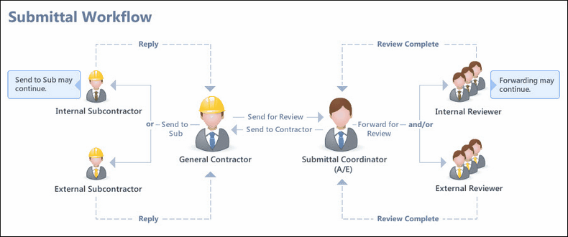
Submittals Module Workflow (Please use when directed by Owner’s Rep)

Slide 10
Submittal Process (Please use when directed by Owner’s Rep)
  Contractor will:
  Import submittal
  Send submittal
  Bundle into Submittal Packages
  Send submittal packages
Architect will:
  Send items for review
  Send packages for confirmation or revision
Contractor will:
  Notify sub-contractors
  Close items

