Slide 1
T&E Improvements
Updates effective 07/01/2018

Slide 2
About the Change Process
Based on analysis of usage patterns and data over the last year
Designed to increase ease of use for our users
Streamline available tools, while reducing clutter on the page
Estimated to save users over 1.5 million clicks

Slide 3


Auto-populating Payment Type
Prior to this update, multiple options for the Payment type meant users had to select one for their expense lines.
With One Card reconciliation occurring in T&E, we were able to merge and simplify the reimbursement expense types.
Reimbursements now populate as Cash/Check/Personal Card
One Card transactions will continue to populate as One Card

Slide 4

Simplify Business Meal Reporting
The Business Meals policy has been updated.
A list of individual attendees and titles is no longer required.
The name of the group and an approximate headcount are acceptable
The group name and headcount can be written on the receipt, or added to the line description.

Slide 5
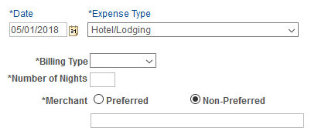

Hotel Wizard Removed
While an itemized hotel folio is still required, breaking hotel expenses into multiple expense lines is no longer necessary.
To streamline data entry on the Hotel/Lodging expense type, we removed:
  Number of Nights and Preferred Merchant
Prior to 07/01
After 07/01

Slide 6
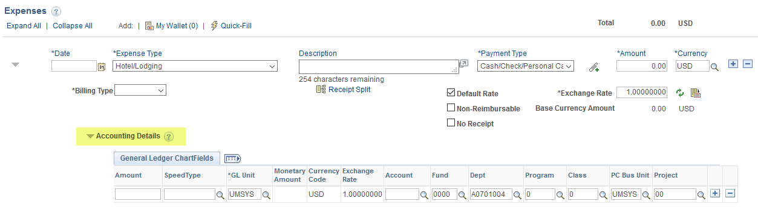
Accounting Details set to Expanded
Prior to this update, users would have to click the symbol before adding their funding/MoCode.
Once an Expense Type is selected, the accounting details section automatically expands.

Slide 7

Auto-populate Billing Type
The billing type field will automatically populate as Non-Travel for select expense types.
Training is available so users can adjust their individual settings if needed.
Non-Travel has only been set on expense types that are rarely used while traveling.
Examples include: Equip – Rental/Repair, Marketing/Promotion, Software, etc.

Slide 8
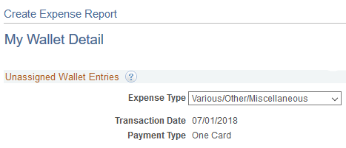
One Card Expense Type Mapping
Improved mapping of One Card transactions will reduce the number of Expense Type changes needed.
Eight merchant category codes were identified and updated.
We estimate a 20% reduction in the amount of Various/Other/Miscellaneous expense types
Should reduce needing to click this!

Slide 9
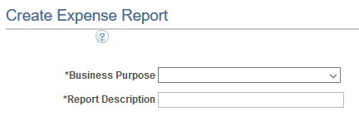
Reference Field Removed
Removing this field simplifies the user experience while still allowing space for information in an expense reports description.
It was easy to mistake this for a required field.
The Reference field was limited to only ten characters, significantly less than what is available in the Report Description or Line Description fields.

